Slide 1

JUST NeRF IT !!
Omri Green, Dheeraj Bhogisetty, Siyuan Huang,
Shreya Bang, Joel John

Slide 2
CONTENT
Objective
Introduction
Pipeline
Dataset Generation & COLMAP
NeRF Architecture
Results & Observations
Challenges
Future Scope

Slide 3
OBJECTIVE
To create a continuous volumetric (3D) scene given a sparse (discrete) set of images of the scene from different viewing angles and generates novel views utilizing a small number of input images. This is done using NeRF.
To add labels to the generated scene which will enable users to replace the existing objects with other volumetric structures or simply add new objects to the scene.

Slide 4
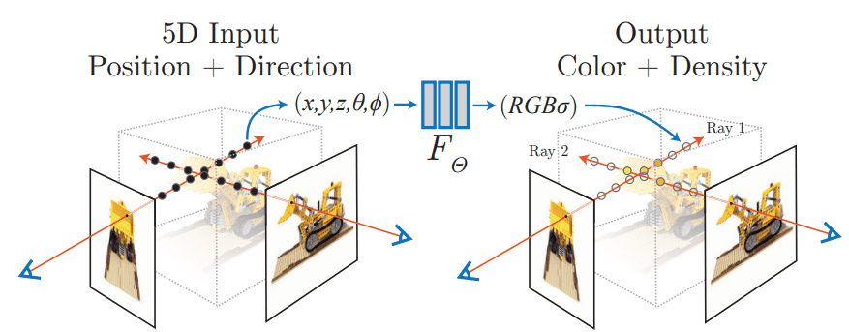
INTRODUCTION
NeRF(Neural Radiance Field) is a strategy to solve view synthesis problem without using a CNN.
The Image is Synthesized by
Sampling 5D coordinates along camera rays
MLP outputs a color and volume density
Render to get the image

Slide 5
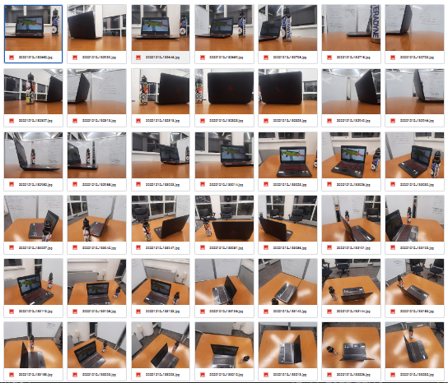
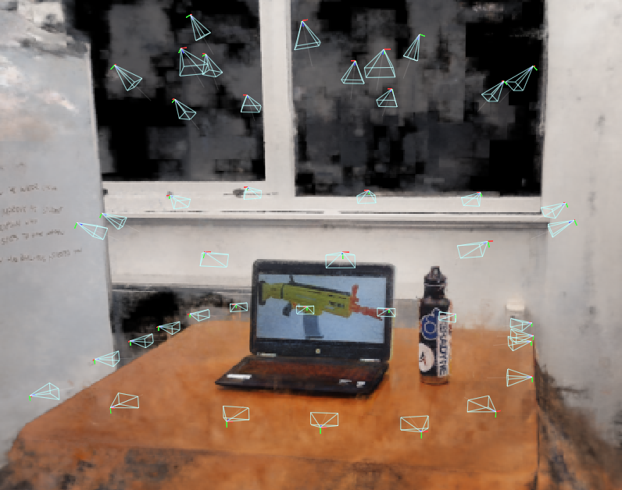
PIPELINE
COLMAP
NeRF

Slide 6
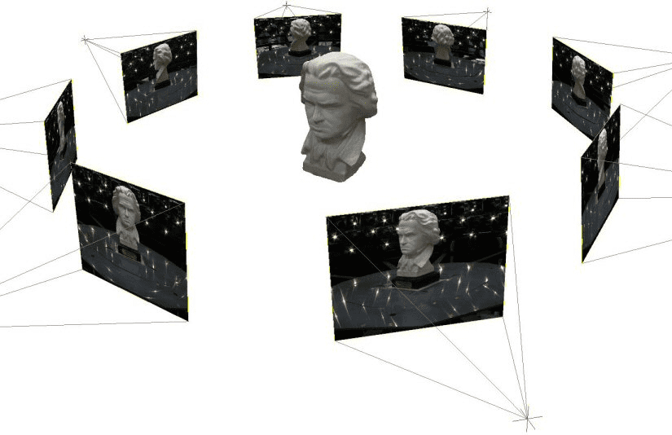
DATASET GENERATION & COLMAP
5D input vector - contains the spatial location and the viewing direction i.e., the pose of the camera.
Camera pose - estimated using computer vision methods.
COLMAP – open-source SfM package
COLMAP calculates the intrinsic and extrinsic properties of the camera and the images. The output is a JSON file that maps each image with its pose.

Slide 7
NeRF ARCHITECTURE
5D Coordinates
Inputs:
- 5D Coordinates – Spatial Location and Viewing Direction
Outputs:
- Volume Density and View-Dependent Emitted Radiance
9 Fully Connected Layers of the Network
- First 8 Layers produce volume density and a 256-dimension feature vector for feature convergence
- Last Layer outputs a view dependent RGB color for rendering
Density Network
Volume Density and Feature Vector
Color Network
View Dependent RGB Color
Rendering
Interactive Scene

Slide 8
RESULTS

Slide 9
DATASET
42 images
Taken at regular intervals covering the complete upper hemisphere

Slide 10
INPUT IMAGES WITH FRAMES

Slide 11
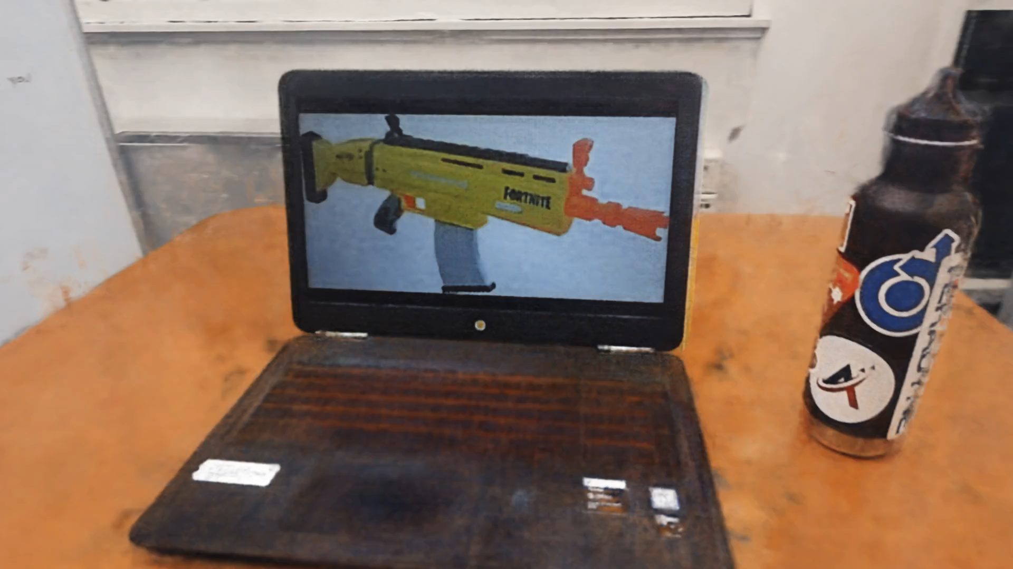

Slide 12
OBSERVATIONS: PART- 1
Reflections can be captured by NeRF
Fully converged scene requires inputs images to capture the scene from all directions
Convergence from real world scenes is not as good as synthetic scenes

Slide 13
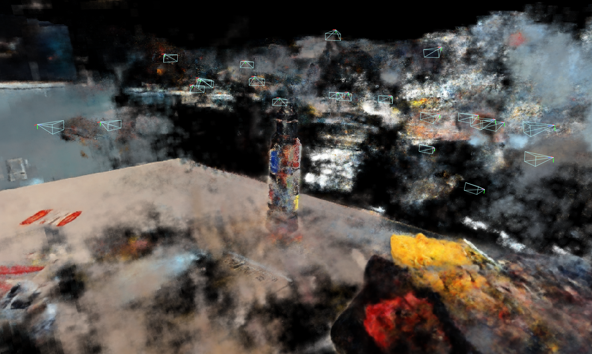
RESULTS FROM A DIFFERENT DATASET

Slide 14
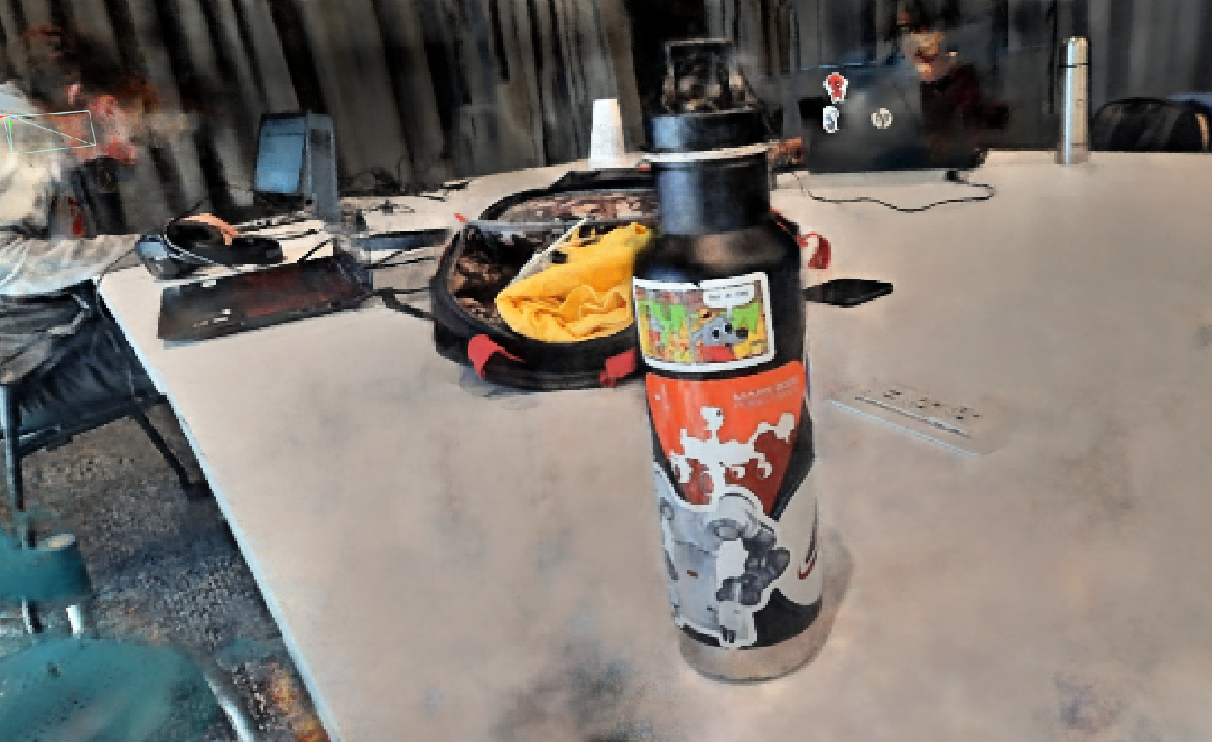
RESULTS FROM A DIFFERENT DATASET

Slide 15
OBSERVATIONS: PART- 2
The input dataset should cover the scene from all angles to get good convergence.
Does not work for dynamic scenes – objects in the scene must be static

Slide 16
CHALLENGES/LIMITATIONS
Achieving faster processing
Convergence for real world scenes
Limitation on the Computational power
Adding the extra heuristic to instant nerf

Slide 17
FUTURE SCOPE
To enable user to add, remove or replace a object in a 3D volumetric scene -
1. Tiny Object Loader: To add 3D objects to the scene
2. Objects can be removed by modifying the NeRF network to include object label

Slide 18
QUESTIONS?

Slide 19
THANK YOU!

